Slide 1



Engineering Electromagnetics 工程电磁场
Youwei Jia 嘉有为

Slide 2

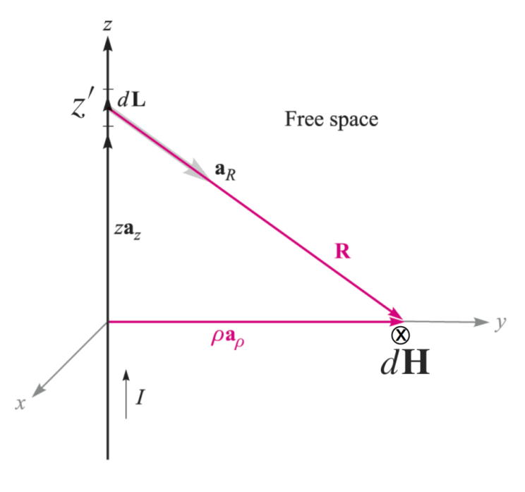
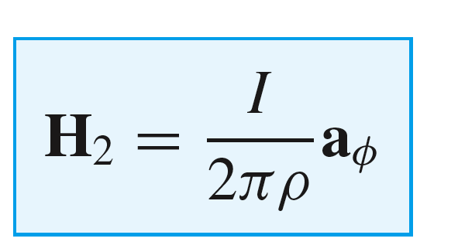
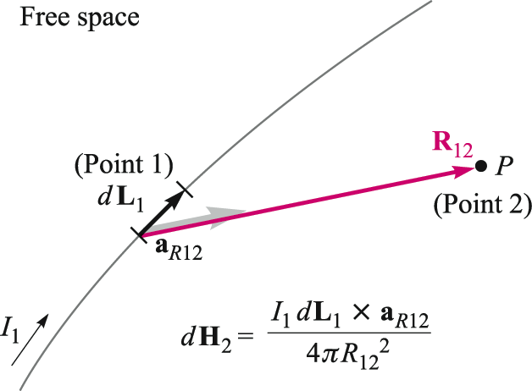
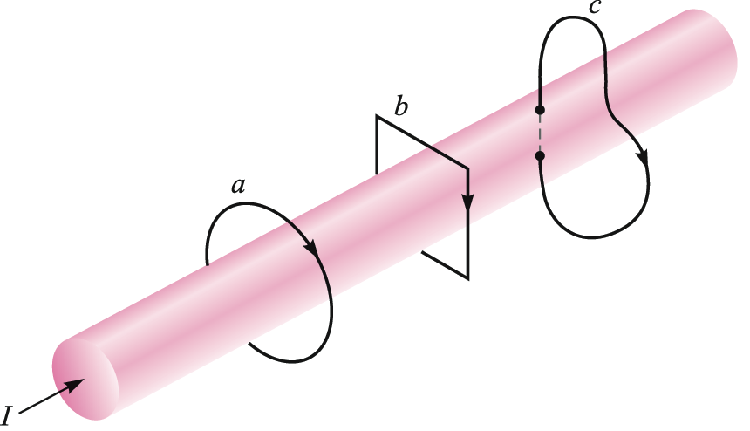
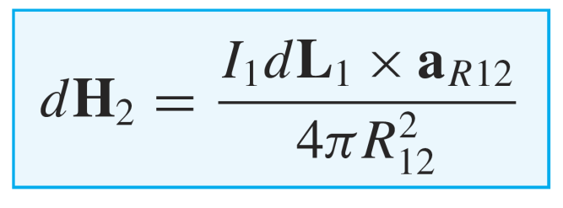
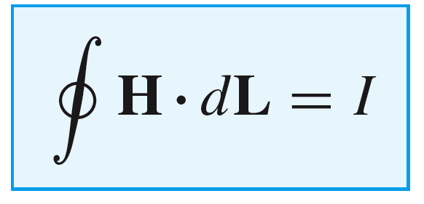
11: The Steady Magnetic Field
Review
Biot-Savart Law
Ampere’s Circuital Law
40

Slide 3
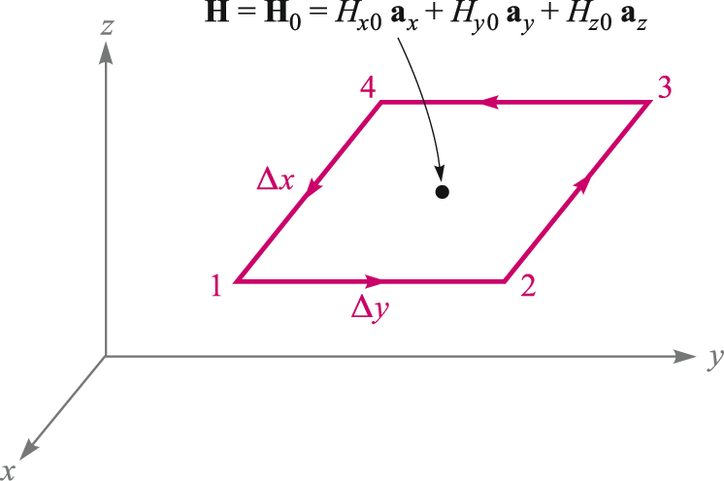
11: The Steady Magnetic Field
Ampere’s Law as Applied to a Small Closed Loop
Consider magnetic field H evaluated at the point shown in the figure. We can approximate the field over the closed path 1234 by making appropriate adjustments in the value of H along each segment.
The objective is to take the closed path integral and ultimately obtain the point form of Ampere’s Law 安培定律的微分形式.
41

Slide 4
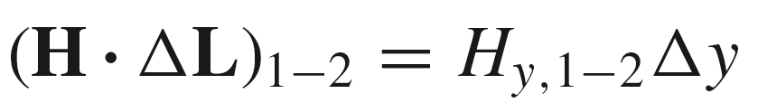
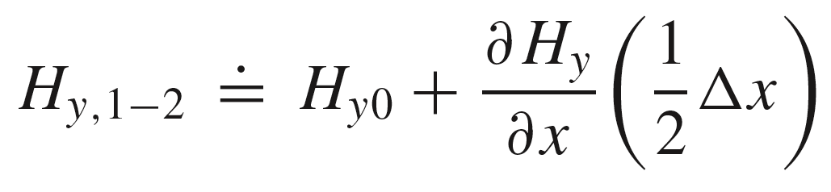
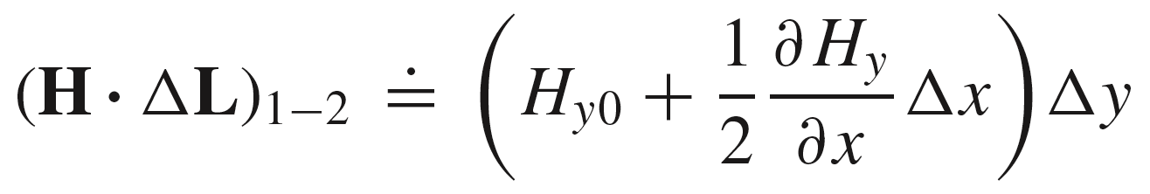
11: The Steady Magnetic Field
Ampere’s Law as Applied to a Small Closed Loop
Approximation of H Along One Segment
Along path 1-2, we may write:
where:
Note: Please refer to Taylor series expansion
And therefore:
42

Slide 5
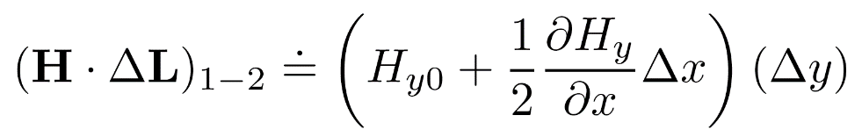
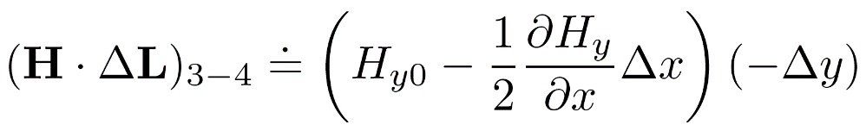
11: The Steady Magnetic Field
Ampere’s Law as Applied to a Small Closed Loop
Contributions of y-Directed Path Segments
The contributions from the front and back sides will be:
The contribution from the opposite side is:
Note the path directions as specified in the figure, and how these determine the signs used .
This leaves the left and right sides…..
43

Slide 6
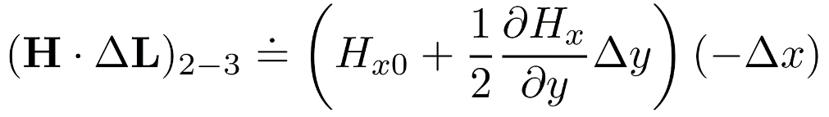
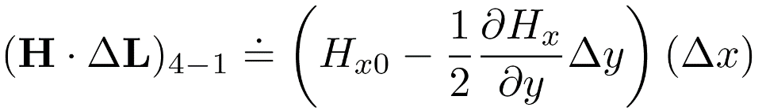
11: The Steady Magnetic Field
Ampere’s Law as Applied to a Small Closed Loop
Contributions of x-Directed Path Segments
Along the right side (path 2-3):
…and the contribution from the left side (path 4-1) is:
The next step is to add the contributions of all four sides to find the closed path integral:
44

Slide 7
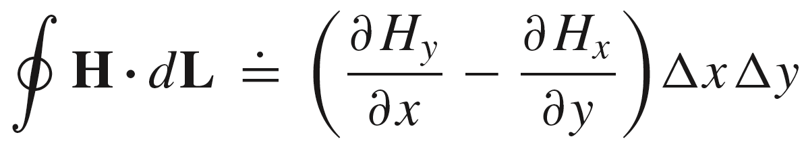
11: The Steady Magnetic Field
Ampere’s Law as Applied to a Small Closed Loop
The total integral will now be the sum:
and using our previous results, the becomes:
45

Slide 8
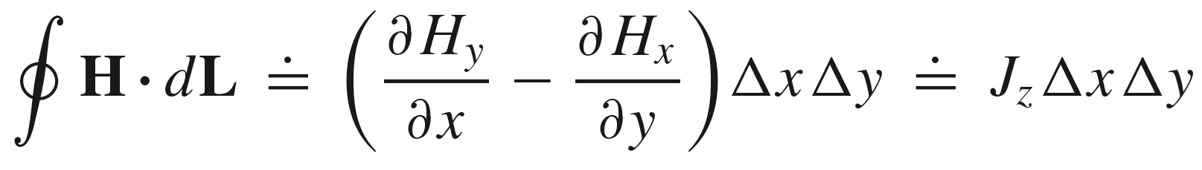
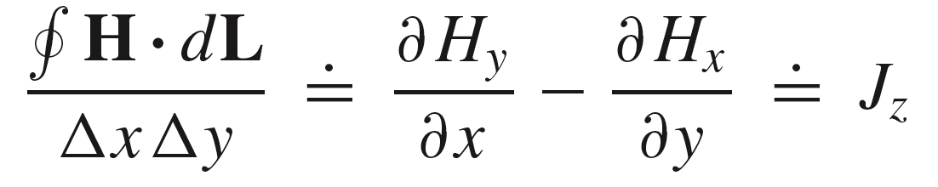

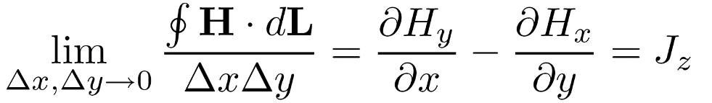
11: The Steady Magnetic Field
Ampere’s Law as Applied to a Small Closed Loop
By Ampere’s Law, the closed path integral of H is equal to the enclosed current, approximated in this case by the current density at the center, multiplied by the loop area:
Dividing by the loop area, we now have:
The expression becomes exact as the loop area
approaches zero:
46

Slide 9
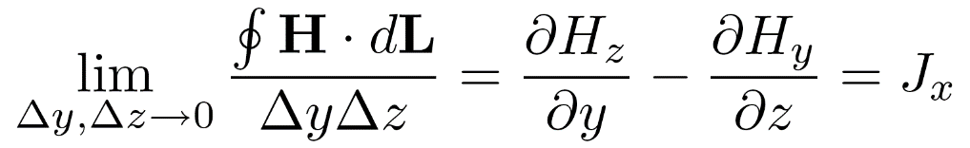

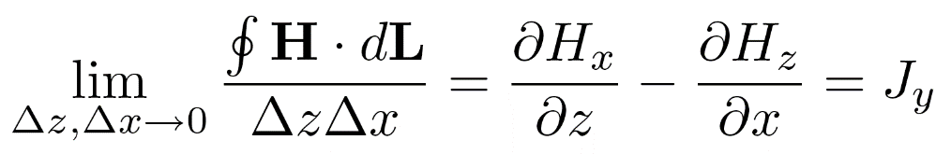

11: The Steady Magnetic Field
Ampere’s Law as Applied to a Small Closed Loop
Other Loop Orientations
The same exercise can be carried with the rectangular loop in the other two orthogonal orientations. The results are:
Loop in yz plane:
Loop in xz plane:
Loop in xy plane:
This gives all three components of the current density field.
47

Slide 10
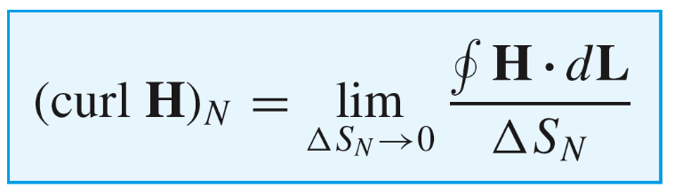
11: The Steady Magnetic Field
Curl of a Vector Field 矢量场的旋度，旋度场
The previous exercise resulted in the rectangular coordinate representation of the Curl of H.
In general, the curl of a vector field is another field that is normal to the original field. The curl component in the direction N, normal to the plane of the integration loop is:
The direction of N is taken using the right-hand convention: With fingers of the right hand oriented in the direction of the path integral, the thumb points in the direction of the normal (or curl).
48

Slide 11
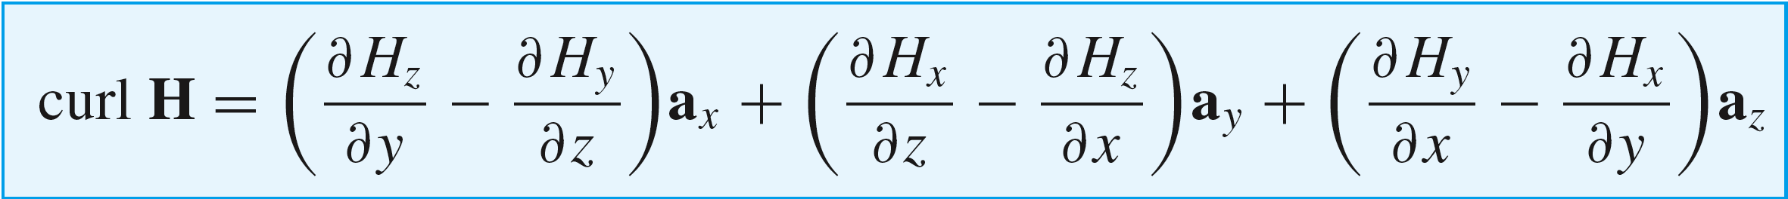
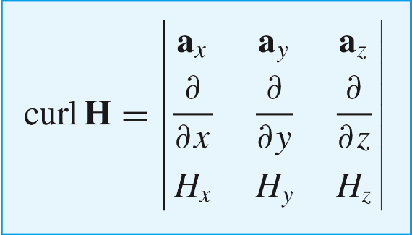
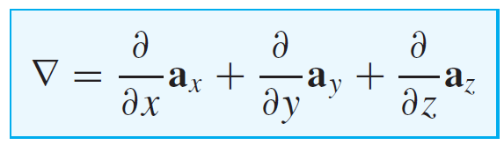

11: The Steady Magnetic Field
Curl in Rectangular Coordinates
Assembling the results of the rectangular loop integration exercise, we find the vector field
that comprises curl H:
An easy way to calculate this is to evaluate the following determinant:
which we see is equivalent to the cross product of the del operator with the field:
48

Slide 12
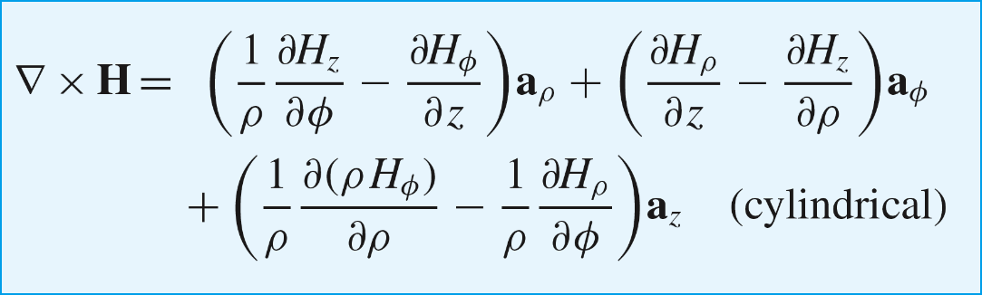
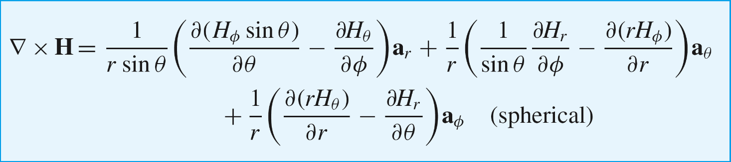
11: The Steady Magnetic Field
Curl in Other Coordinate Systems
…a little more complicated!
Look these up as needed….
49

Slide 13

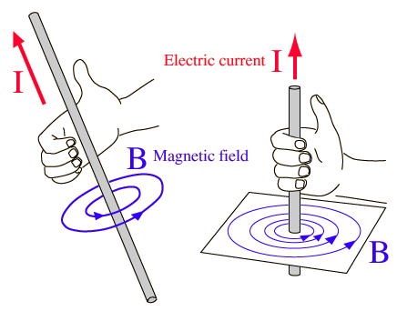
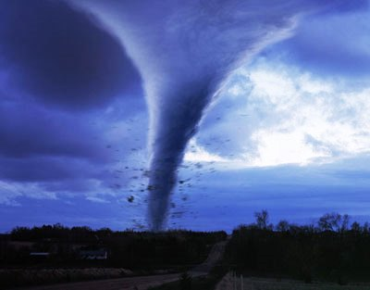

11: The Steady Magnetic Field
Visualization of Curl
50

Slide 14
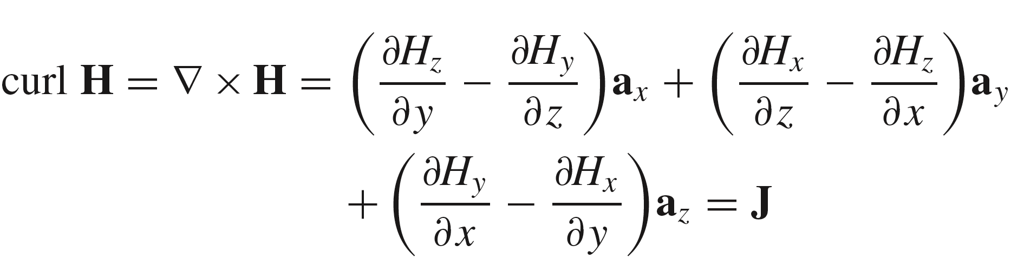
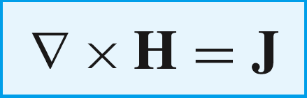
11: The Steady Magnetic Field
Another Maxwell Equation: Point form of Ampere’s Law
It has just been demonstrated that:
…..which is in fact one of Maxwell’s equations for static fields:
This is Ampere’s Circuital Law in point form.
51

Slide 15
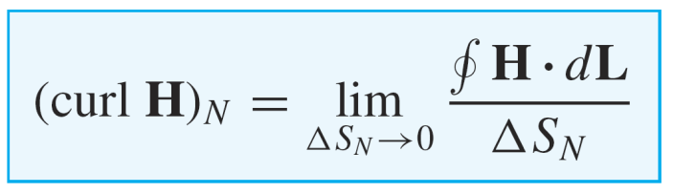
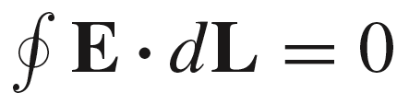
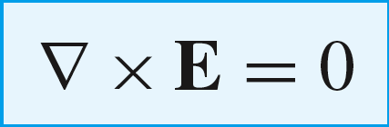
11: The Steady Magnetic Field
Curl of Conservative Field
We already know that for a static electric field:
This means that:
(applies to a static electric field)
Recall the condition for a conservative field: that is, its closed path integral is zero everywhere.
Therefore, a field is conservative if it has zero curl at all points over which the field is defined.
52

Slide 16
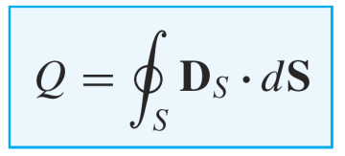
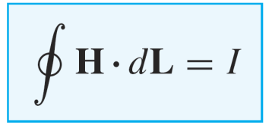
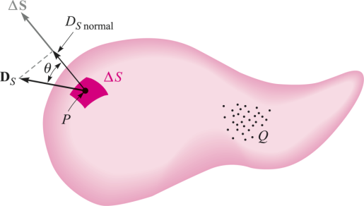
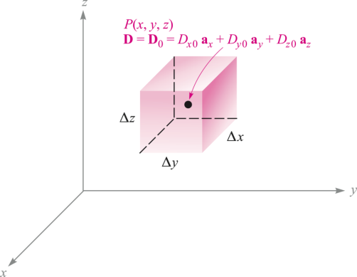

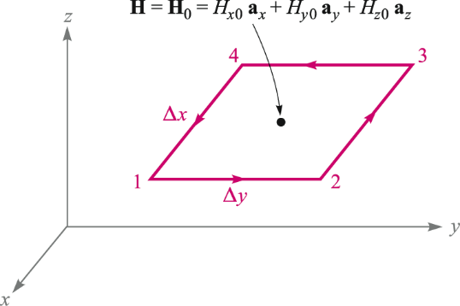
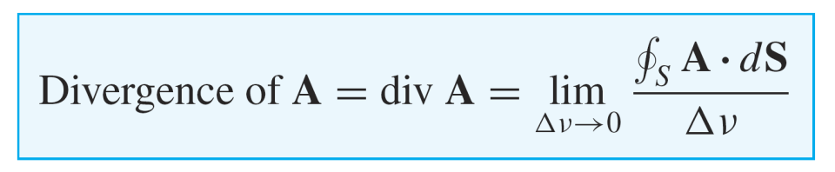
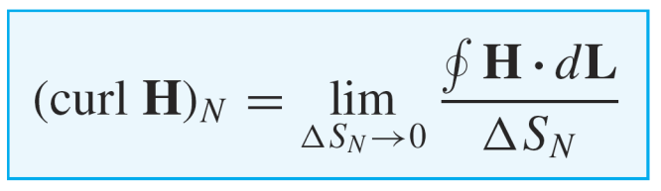
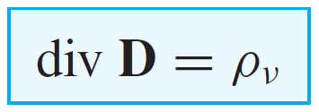

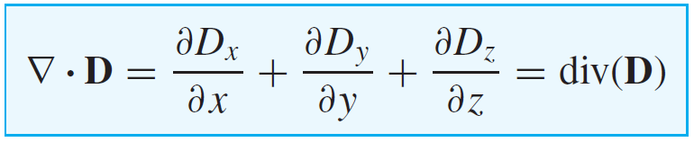
11: The Steady Magnetic Field
Divergence vs. Curl 散度，旋度
Gauss’ Law
Ampere’s Law
53

Slide 17

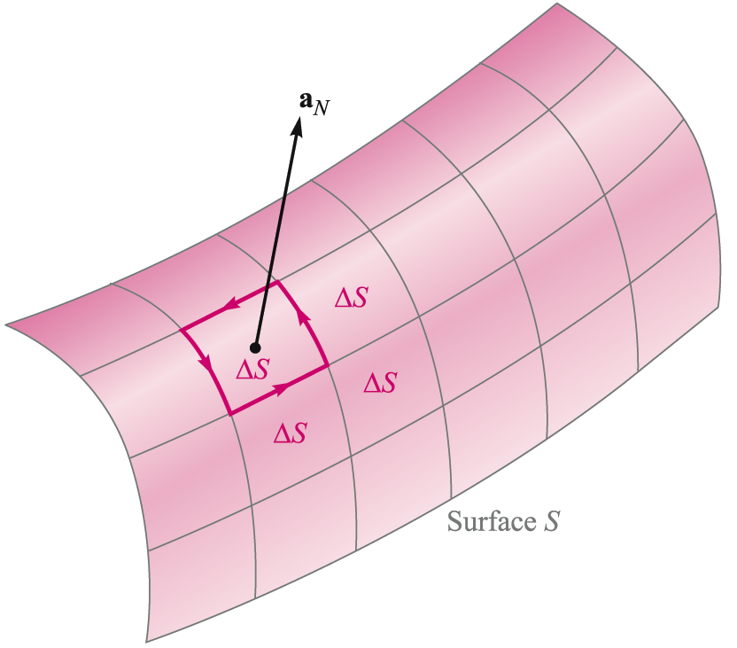
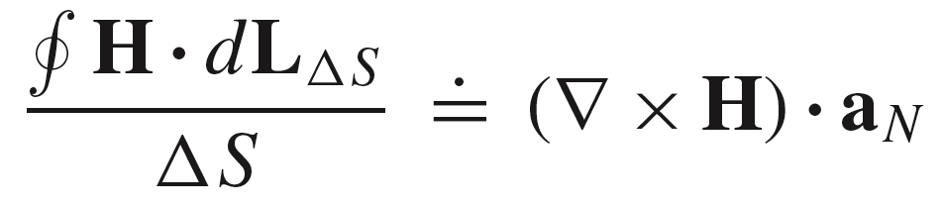
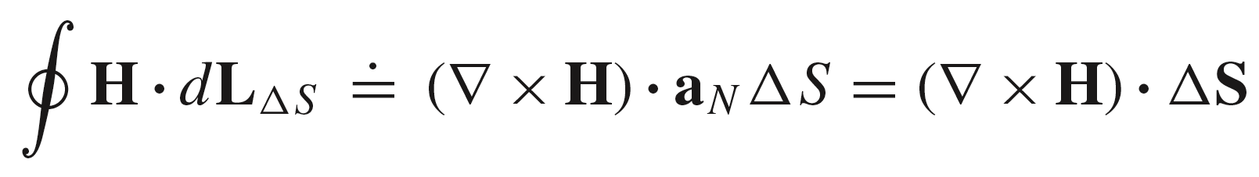
11: The Steady Magnetic Field
Curl Applied to Partitions of a Large Surface
Surface S is paritioned into sub-regions, each of small area
The curl component that is normal to a surface element can
be written using the definition of curl:
or:
We now apply this to every partition on the surface, and add the results….
54

Slide 18

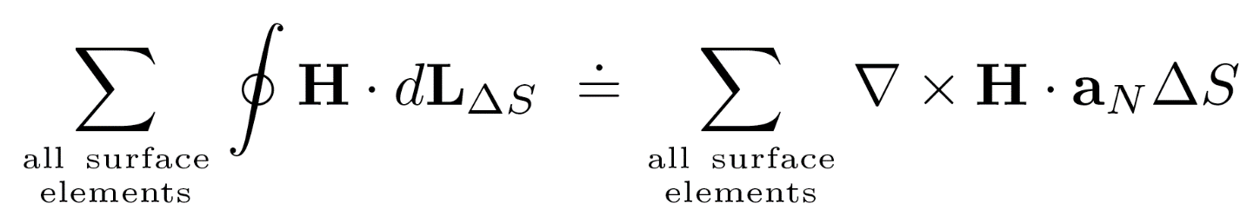
11: The Steady Magnetic Field
Curl Applied to Partitions of a Large Surface
We now evaluate and add the curl contributions from all surface elements, and note that
adjacent path integrals will all cancel!
Cancellation here:
.
This means that the only contribution to the overall path integral will be around the outer periphery of surface S.
No cancellation here:
Using our previous result, we now write:
55

Slide 19


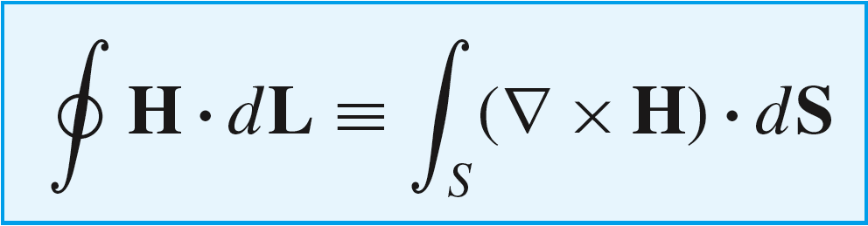
11: The Steady Magnetic Field
Stokes’ Theorem
We now take our previous result, and take the limit as
.
In the limit, this side
becomes the path integral
of H over the outer perimeter
because all interior paths
cancel
In the limit, this side
becomes the integral
of the curl of H over
surface S
The result is Stokes’ Theorem
This is a valuable tool to have at our disposal, because it gives us two ways to evaluate the same thing!
56

Slide 20
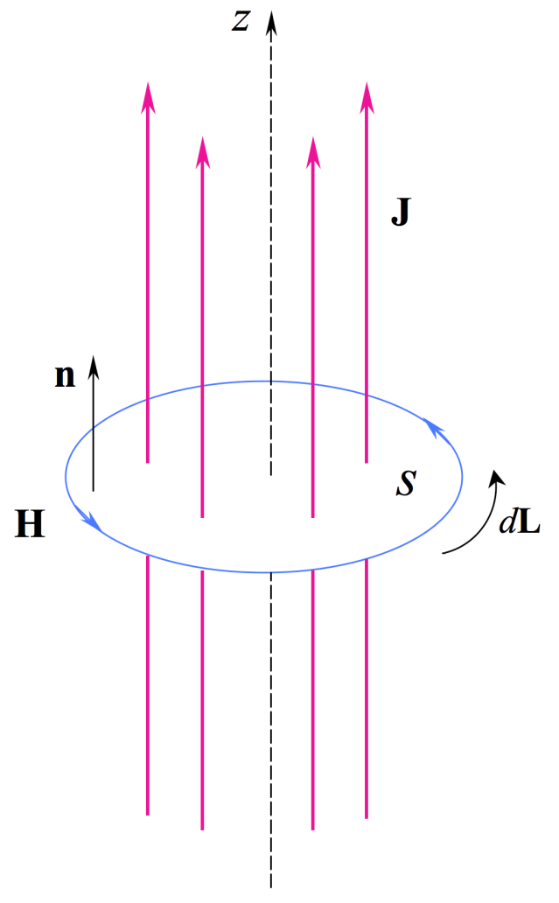

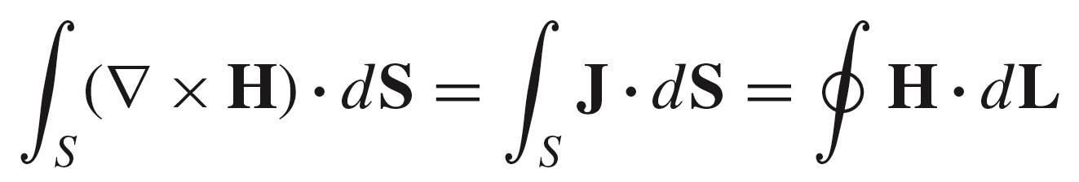
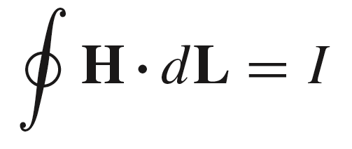
11: The Steady Magnetic Field
Obtaining Ampere’s Circuital Law in Integral Form, using Stokes’ Theorem
Begin with the point form of Ampere’s Law for static fields:
Integrate both sides over surface S:
..in which the far right hand side is found from the left hand side using Stokes’ Theorem. The closed path integral is taken around the perimeter of S. Again, note that we use the right-hand convention in choosing the direction of the path integral.
The center expression is just the net current through surface S,
so we are left with the integral form of Ampere’s Law:
57

Slide 21






11: The Steady Magnetic Field
Stokes’ Theorem vs. Divergence Theorem
.
Note:
58

Slide 22








11: The Steady Magnetic Field
Magnetic Flux and Magnetic Flux Density
We are already familiar with the concept of electric flux:
Coulombs
in which the electric flux density in free space is:
and where the free space permittivity is
In a similar way, we can define the magnetic flux in units of Webers (Wb):
Webers
in which the magnetic flux density (or magnetic induction磁感应强度) in free space is:
and where the free space permeability 磁导率 is
59

Slide 23




11: The Steady Magnetic Field
A Key Property of B
If the flux is evaluated through a closed surface, we have in the case of electric flux, Gauss’ Law:
If the same were to be done with magnetic flux density, we would find:
The implication is that (for our purposes) there are no magnetic charges -- specifically, no point sources of magnetic field exist. A hint of this has already
been observed, in that magnetic field lines always close on themselves.
60

Slide 24


11: The Steady Magnetic Field
Another Maxwell Equation
We may rewrite the closed surface integral of B using the divergence theorem, in which the right hand integral is taken over the volume surrounded by the closed surface:
Because the result is zero, it follows that
This result is known as Gauss’ Law for the magnetic field in point form.
61

Slide 25



11: The Steady Magnetic Field
Maxwell’s Equations for Static Fields
We have now completed the derivation of Maxwell’s equations for no time variation. In point form, these are:
Gauss’ Law for the electric field
Conservative property of the static electric field
Ampere’s Circuital Law
Gauss’ Law for the Magnetic Field
where, in free space:
Note: Significant changes in the above four equations will occur when the fields are allowed to vary with time, as we will see later.
62

Slide 26

11: The Steady Magnetic Field
Maxwell’s Equations for Static Fields in Large Scale Form
The divergence theorem and Stokes’ theorem can be applied to the previous four point form equations to yield the integral form of Maxwell’s equations for static fields:
Gauss’ Law for the electric field
Conservative property of the static electric field
Ampere’s Circuital Law
Gauss’ Law for the magnetic field
63

Slide 27





11: The Steady Magnetic Field
Example: Magnetic Flux Within a Coaxial Line
Consider a length d of coax, as shown here. The magnetic field strength between conductors is:
and so:
The magnetic flux is now the integral of B over the
flat surface between radii a and b, and of length d along z:
B
d
The result is:
The coax line thus “stores” this amount of magnetic flux in the region between conductors. This will have importance when we discuss inductance in a later lecture.
64

Slide 28





11: The Steady Magnetic Field
Scalar Magnetic Potential 标量磁位
We are already familiar with the relation between the scalar electric potential and electric field:
So it is tempting to define a scalar magnetic potential such that:
This rule must be consistent with Maxwell’s equations, so therefore:
But the curl of the gradient of any function is identically zero! Therefore, the scalar magnetic potential is valid only in regions where the current density is zero (such as in free space).
So we define scalar magnetic potential with a condition:
65

Slide 29




11: The Steady Magnetic Field
Further Requirements on the Scalar Magnetic Potential
The other Maxwell equation involving magnetic field must also be satisfied. This is:
in free space
Therefore:
..and so the scalar magnetic potential satisfies Laplace’s equation (again with the restriction that current density must be zero):
Note: Poission’s equation for electrostatic field:
66

Slide 30





11: The Steady Magnetic Field
Example: Coaxial Transmission Line
With the center conductor current flowing out of the screen, we have
Thus:
So we solve:
.. and obtain:
where the integration constant has been set to zero
67

Slide 31










11: The Steady Magnetic Field
Ambiguities in the Scalar Magnetic Potential
The scalar potential is now:
where the potential is zero at
At point P (
) the potential is
But wait! As increases to
we have returned to the same physical location, and
the potential has a new value of -I.
In general, the potential at P will be multivalued, and will
acquire a new value after each full rotation in the xy plane:
68

Slide 32



11: The Steady Magnetic Field
Overcoming the Ambiguity
To remove the ambiguity, we construct a mathematical barrier at any value of phi. The angle domain cannot cross this barrier in either direction, and so the potential function is restricted to angles on either side. In the present case we choose the barrier to lie at so that
The potential at point P is now single-valued:
Barrier at
69

Slide 33





11: The Steady Magnetic Field
Vector Magnetic Potential 矢量磁位，磁矢位
We make use of the Maxwell equation:
.. and the fact that the divergence of the curl of any vector field is identically zero (show this!)
This leads to the definition of the magnetic vector potential, A:
Thus:
and Ampere’s Law becomes
70

Slide 34





11: The Steady Magnetic Field
Expressions for Potential
Consider a differential elements, shown here. On the left is a point charge represented
by a differential length of line charge. On the right is a differential current element. The setups for obtaining potential are identical between the two cases.
Line Charge
Line Current
Scalar Electrostatic Potential
Vector Magnetic Potential
71

Slide 35



11: The Steady Magnetic Field
General Expressions for Vector Potential
For large scale charge or current distributions, we would sum the differential
contributions by integrating over the charge or current, thus:
The closed path integral is taken because the current must
close on itself to form a complete circuit.
For surface or volume current distributions, we would have, respectively:
or
in the same manner that we used for scalar electric potential.
72

Slide 36




11: The Steady Magnetic Field
Example
We continue with the differential current element as shown here:
In this case
becomes at point P:
Now, the curl is taken in cylindrical coordinates:
This is the same result as found using the Biot-Savart Law (as it should be)
73

Slide 37




11: The Steady Magnetic Field
Equation for the Vector Potential
We start with:
Then, introduce a vector identity that defines the vector Laplacian:
Using a (lengthy) procedure (see Sec. 7.7) it can be proven that
We are therefore left with
74

Slide 38




11: The Steady Magnetic Field
Equation for the Vector Potential
We now have
In rectangular coordinates:
(not so simple in the
other coordinate systems)
The equation separates to give:
This indicates that the direction of A will be the same as that of the current to which it is associated. Also, we get three scalar Poission’s equations.
75

Slide 39


HW-7
76

